Slide 1
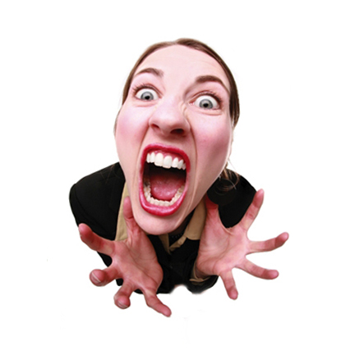

Slide 2
Are you usually stressed?
Do you normally feel full of energy or low on energy?
Do you wait until the last minute to do your homework?
Do you like to work under pressure, or do you prefer to

Slide 3
Now I´m full of energy!

Slide 4
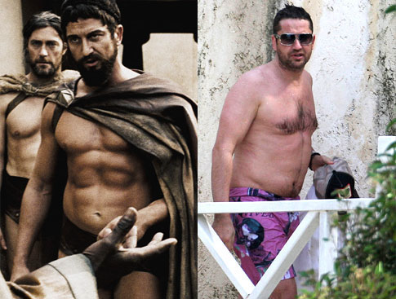

Slide 5
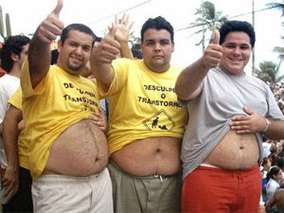
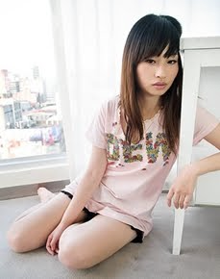
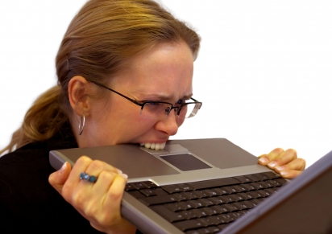

Slide 6
Dear Donna

Slide 7

